Slide 1
Week-5
11th Sept- 15th sept
Name: - ARKA KUMAR SAHA
Alias ID: - INAUFS
Batch: - 1

Slide 2
11th September
Doubt session organized
Hands on in Azure Data Factory.
Creation of dataflow and CDC.

Slide 3
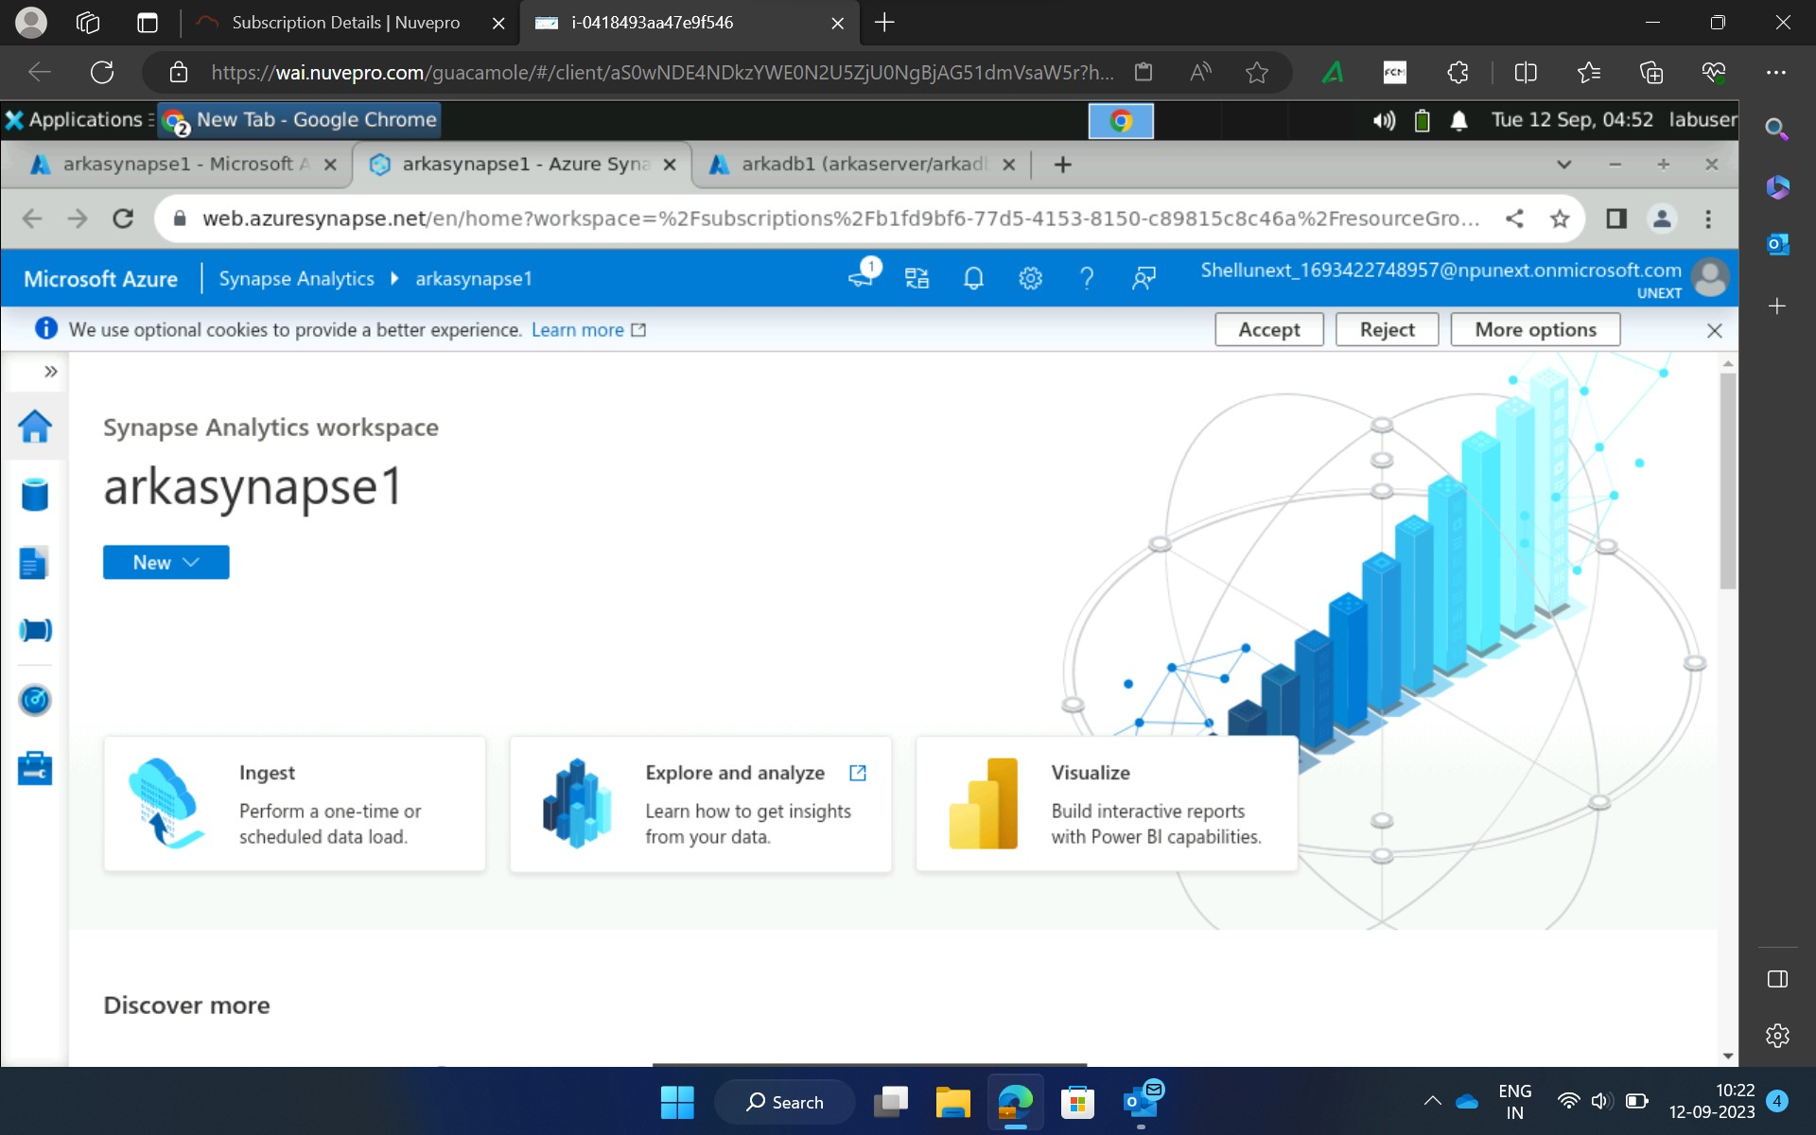
12TH September
Creation of Azure Synapse account

Slide 4
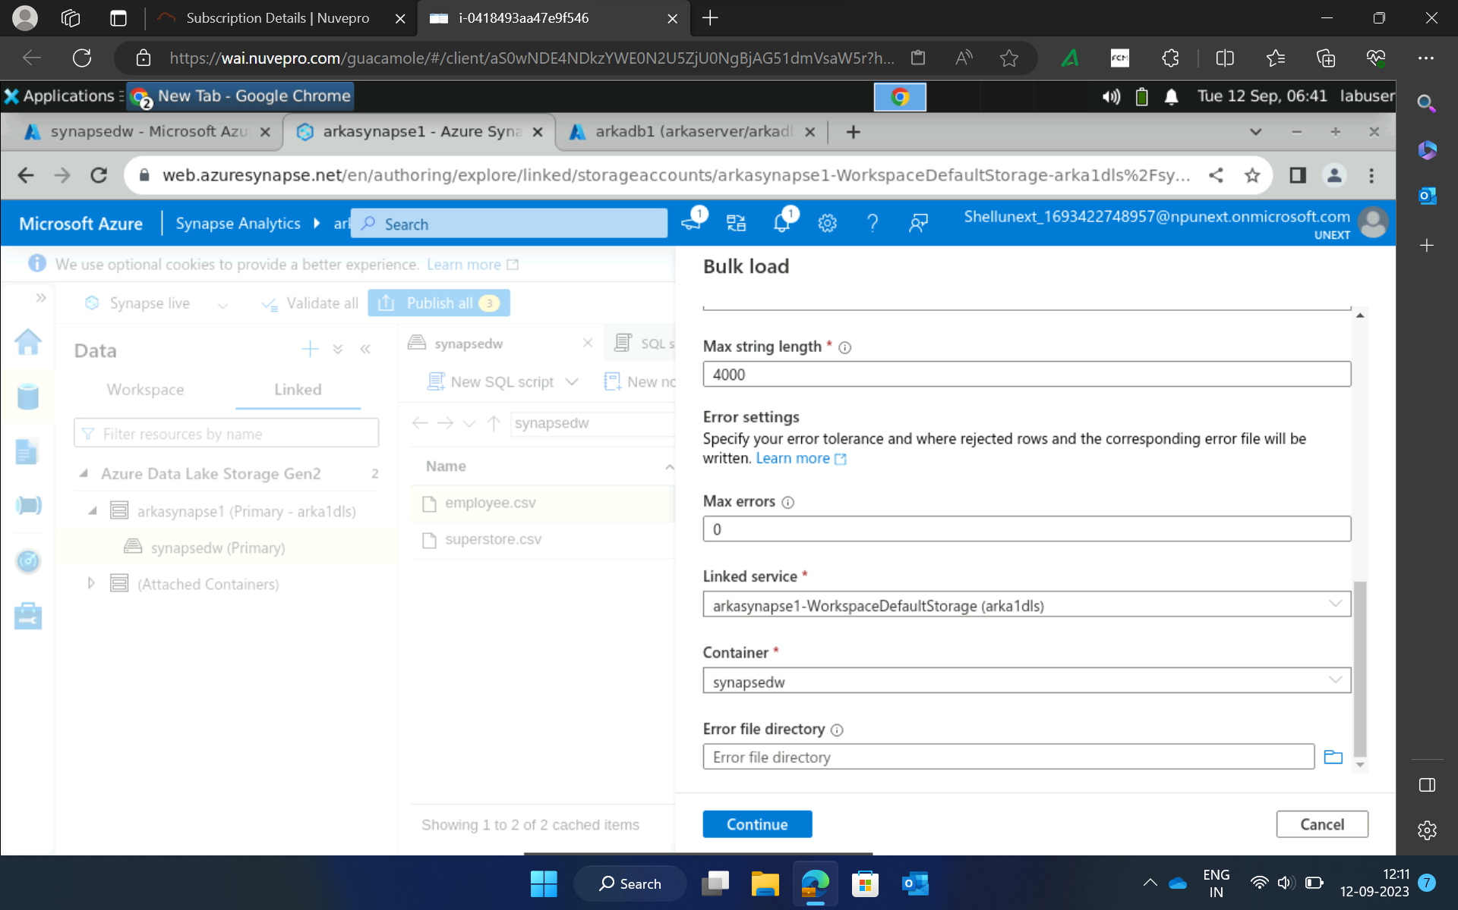
Bulk loading: -

Slide 5
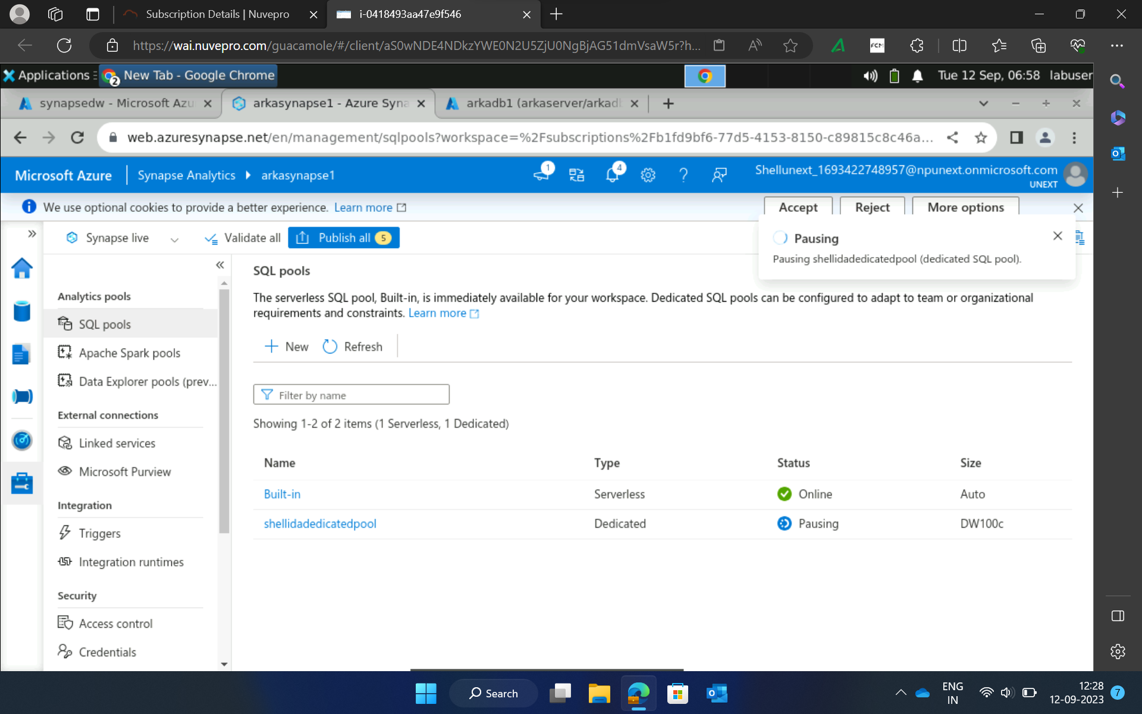
Building SQL pools

Slide 6
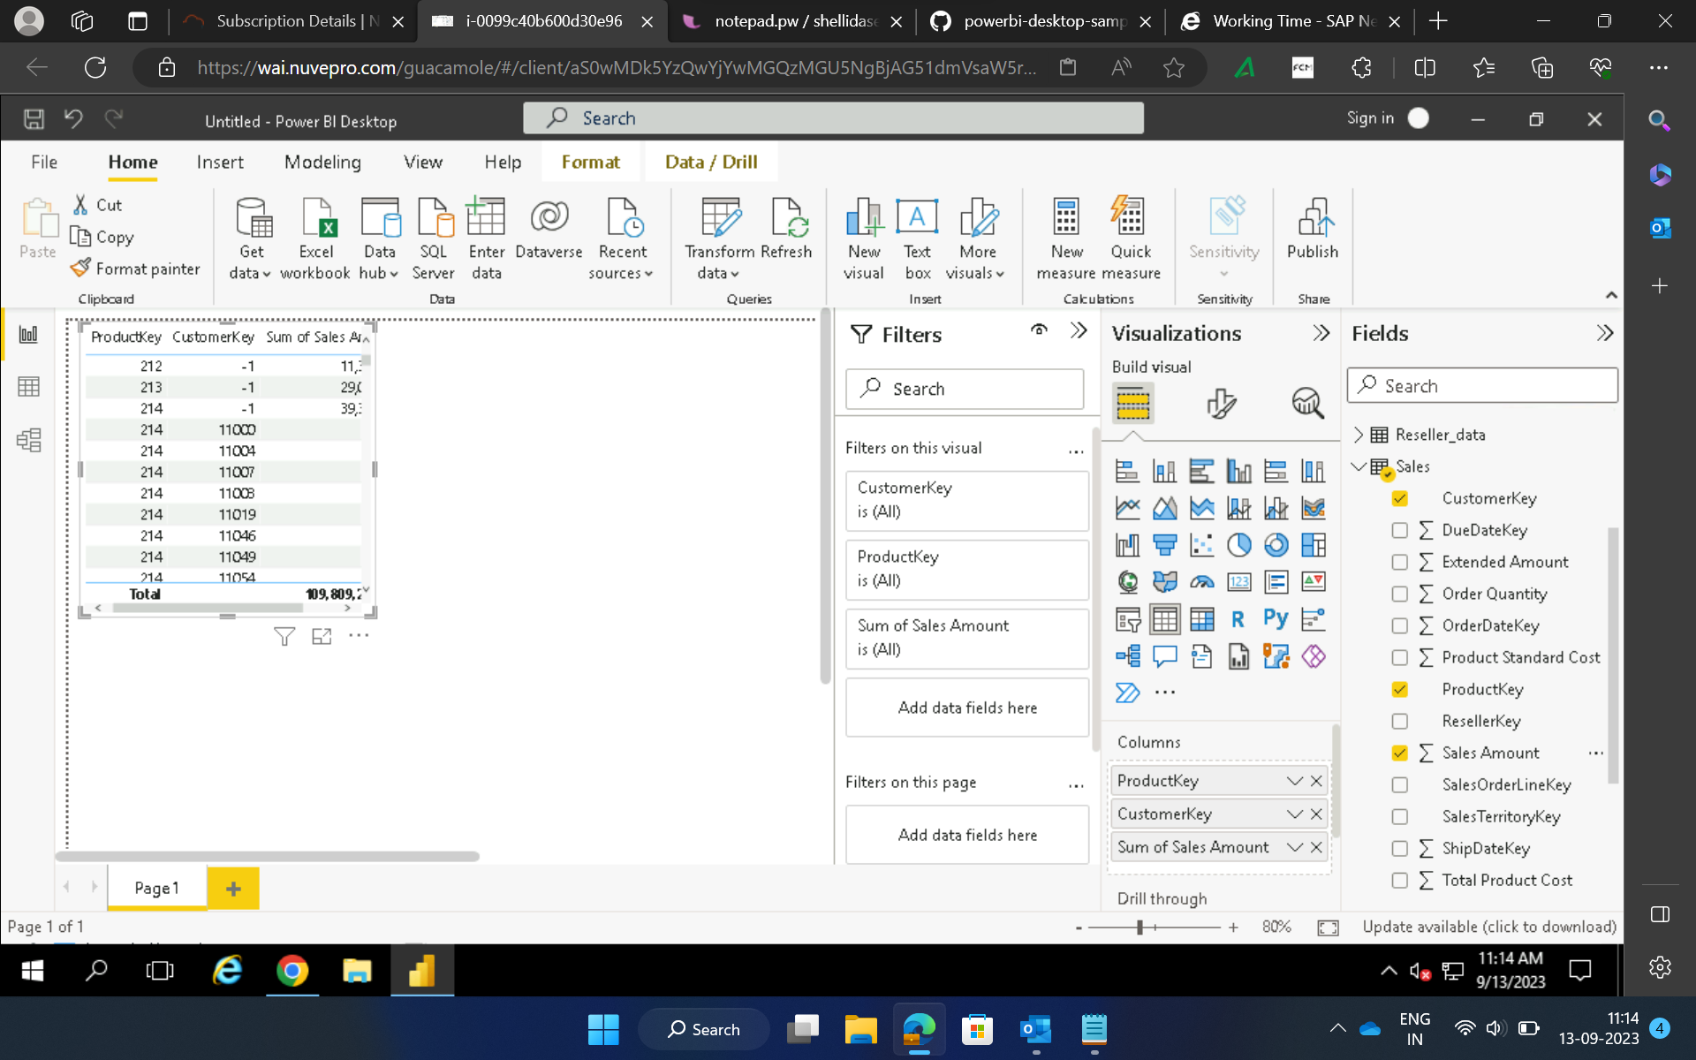
13th September
Introduction to PowerBi

Slide 7
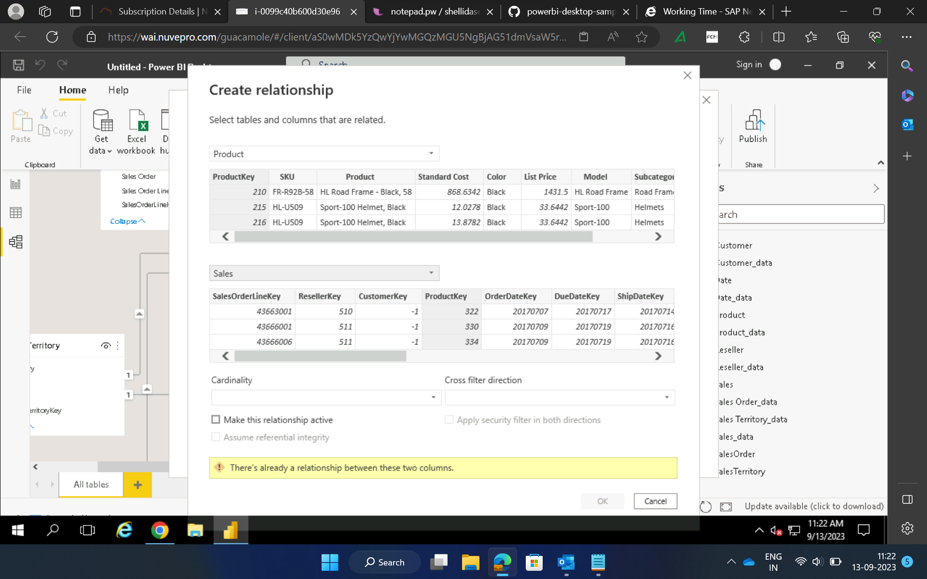
Creating relationships between tables

Slide 8
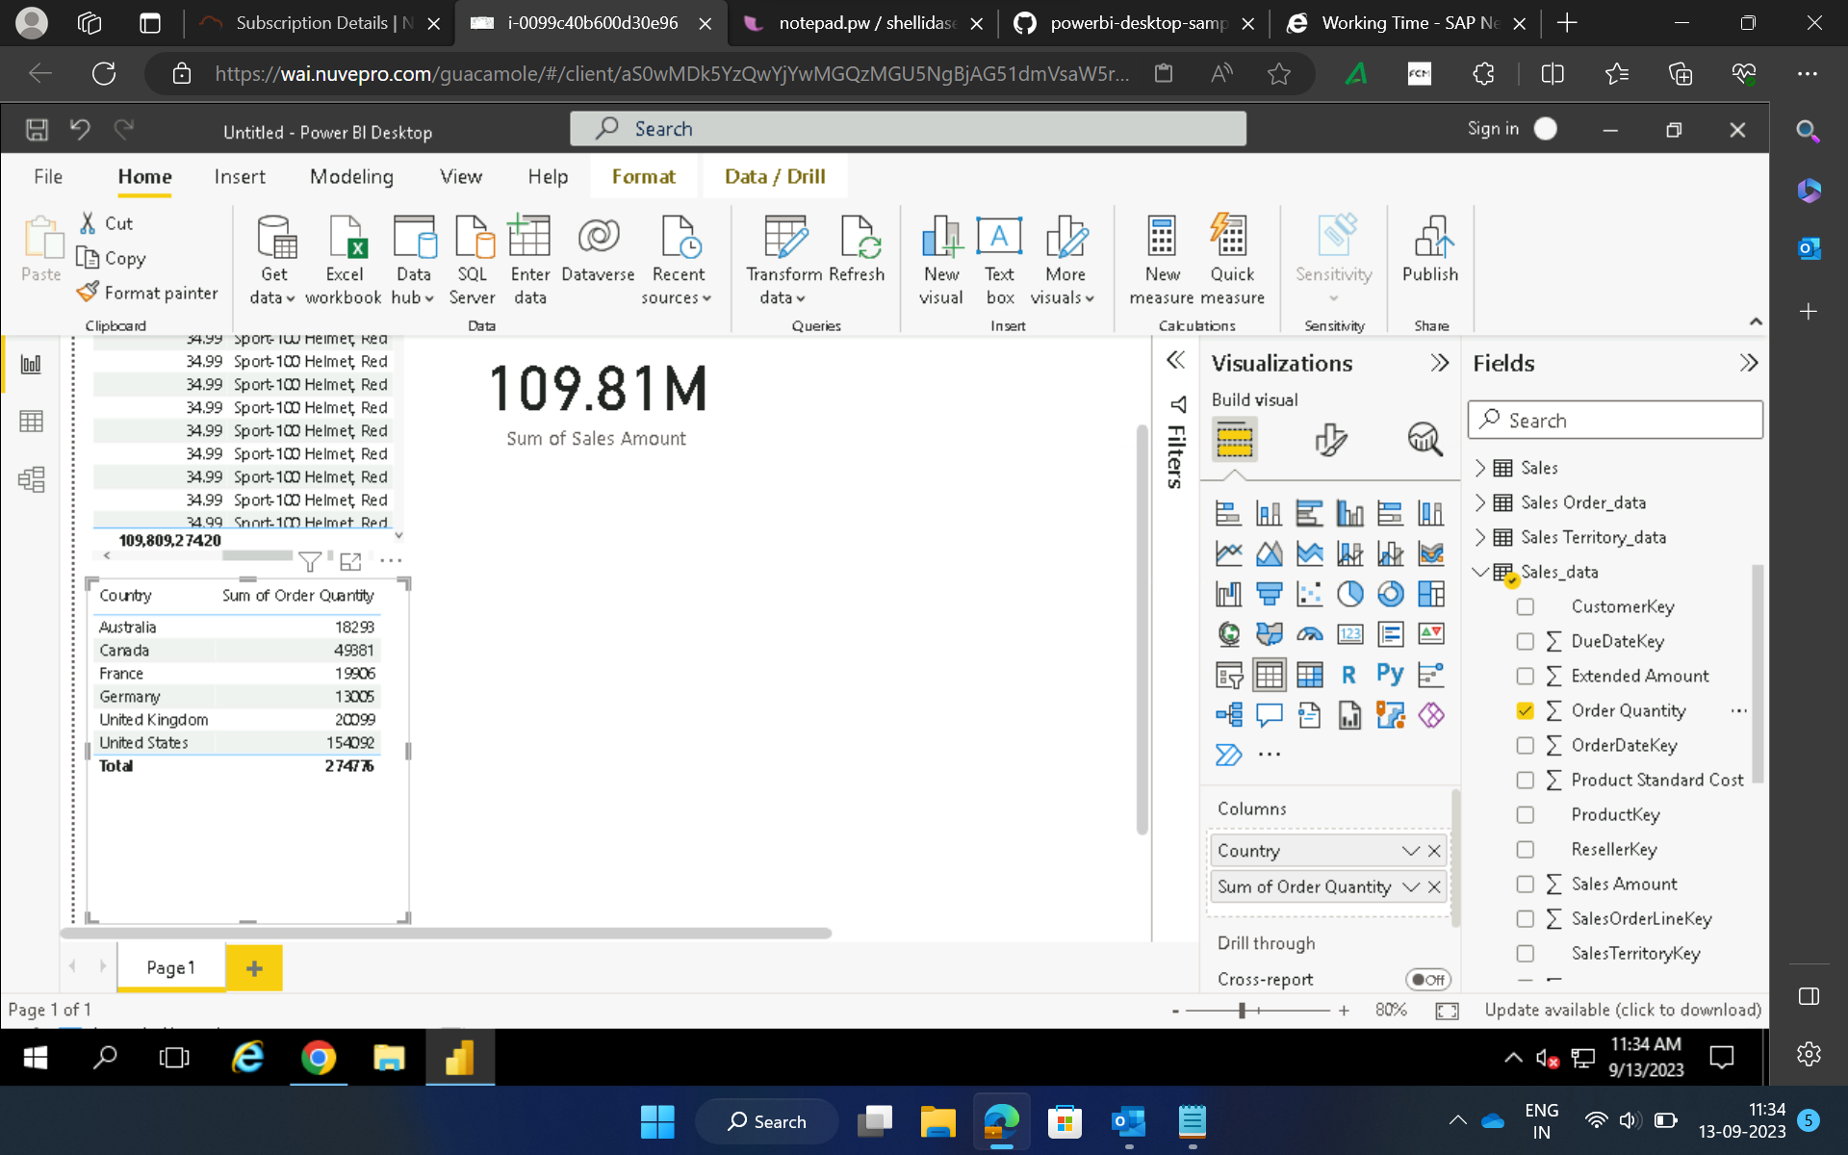
Creating reports

Slide 9
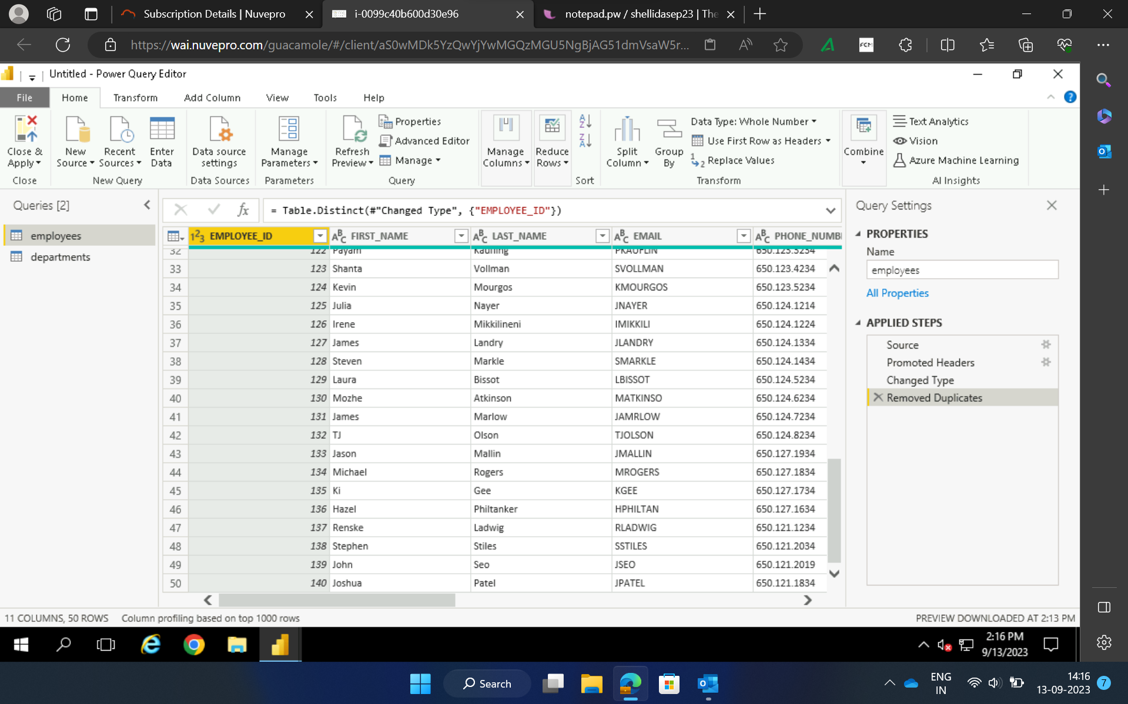
Removing duplicates

Slide 10
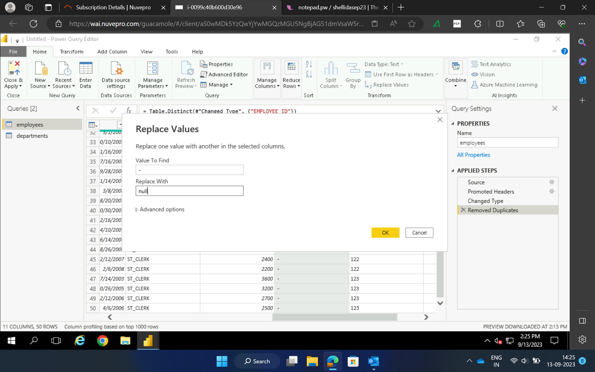
Replacing values

Slide 11
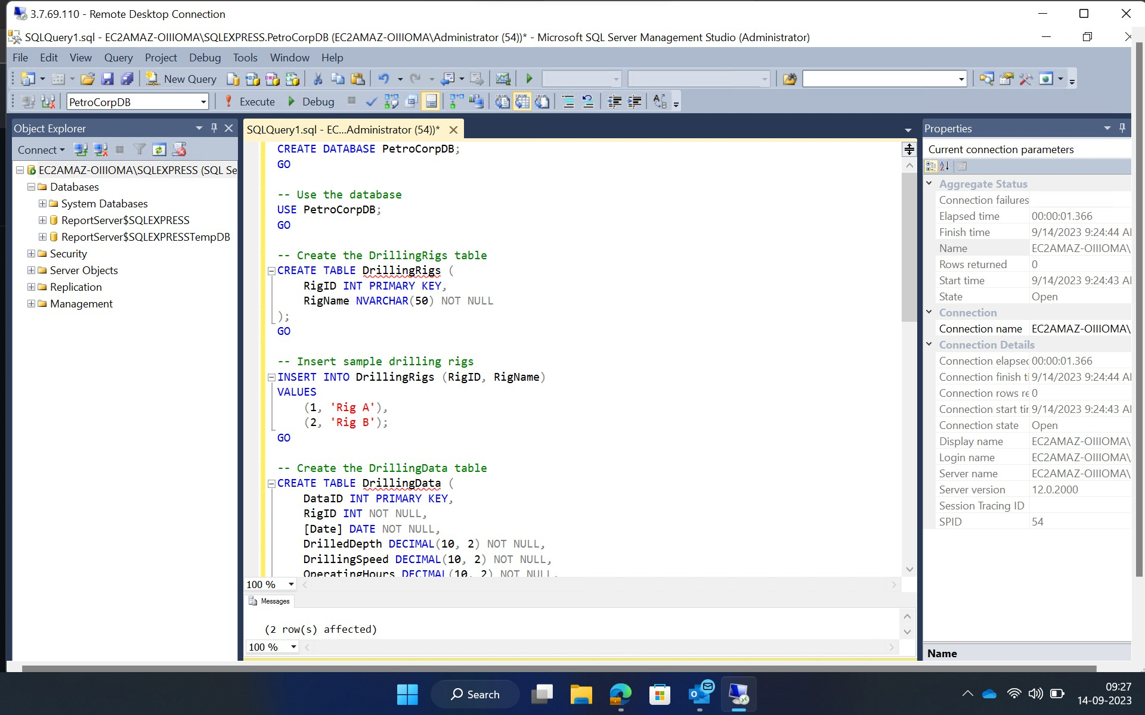
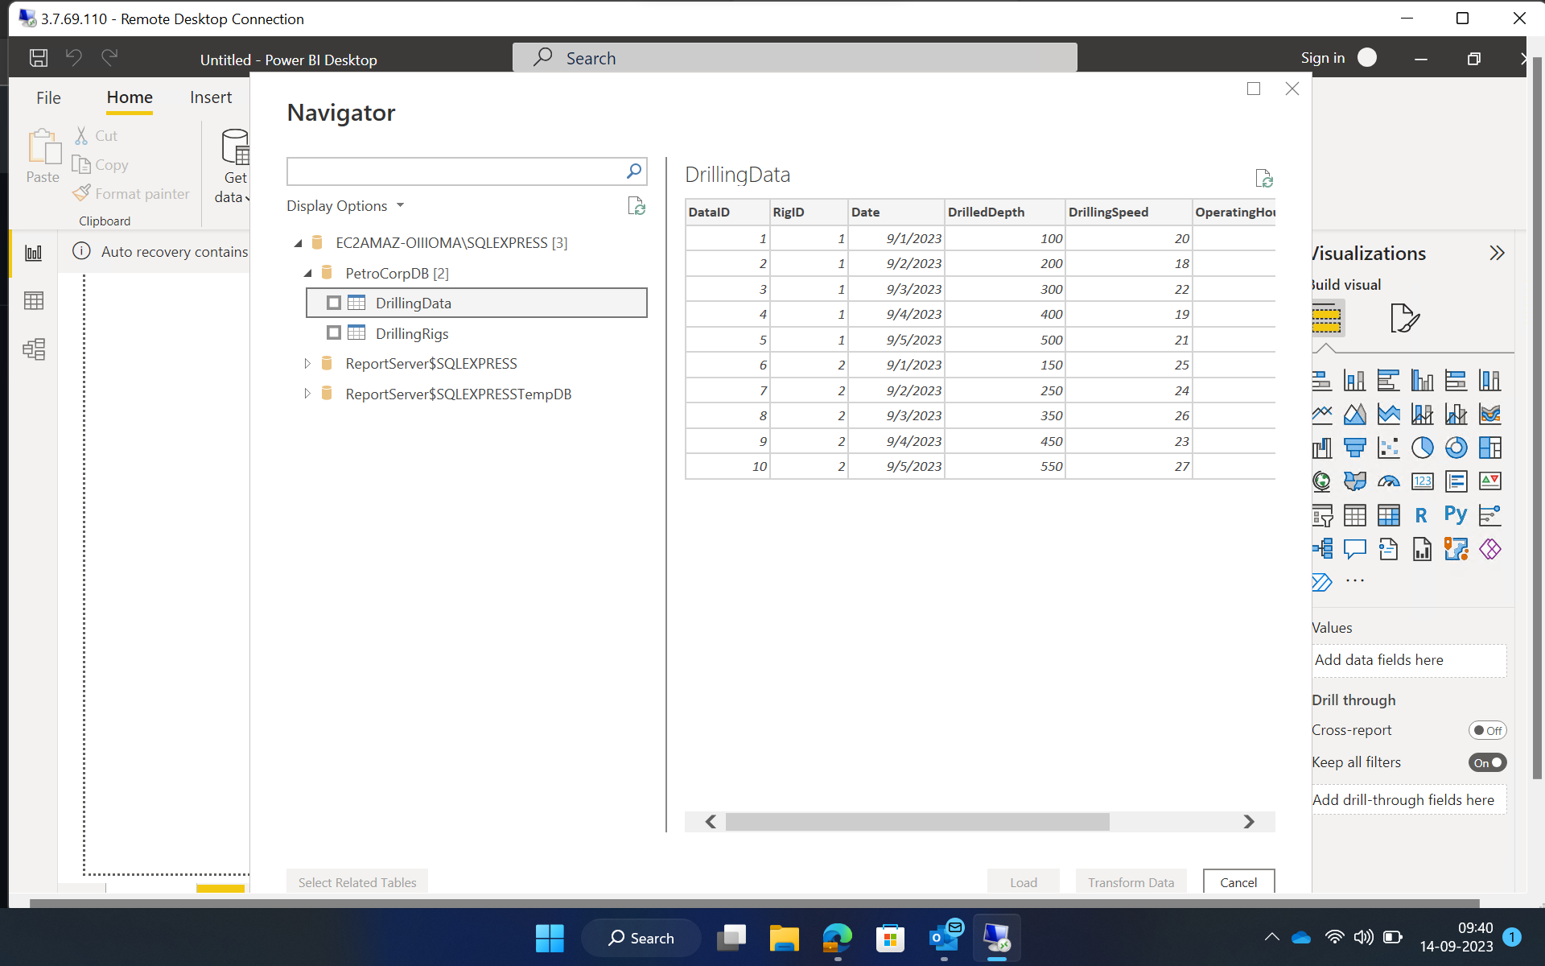
14th September
Creating Database from SQL Server Management Studio and loading that data in PowerBi.

Slide 12
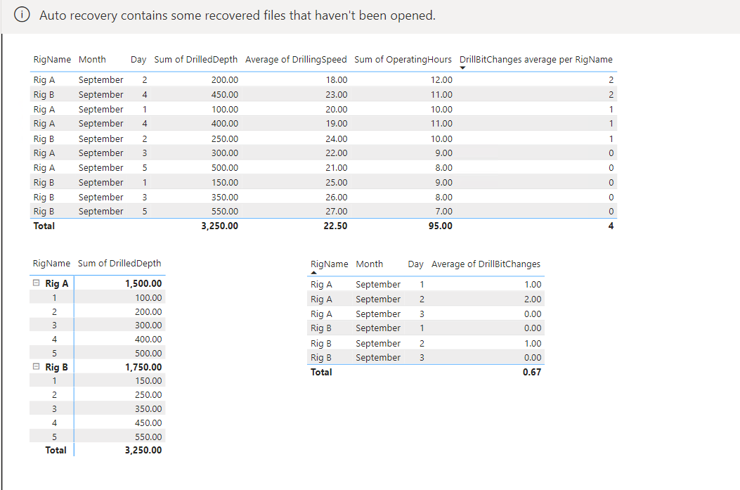
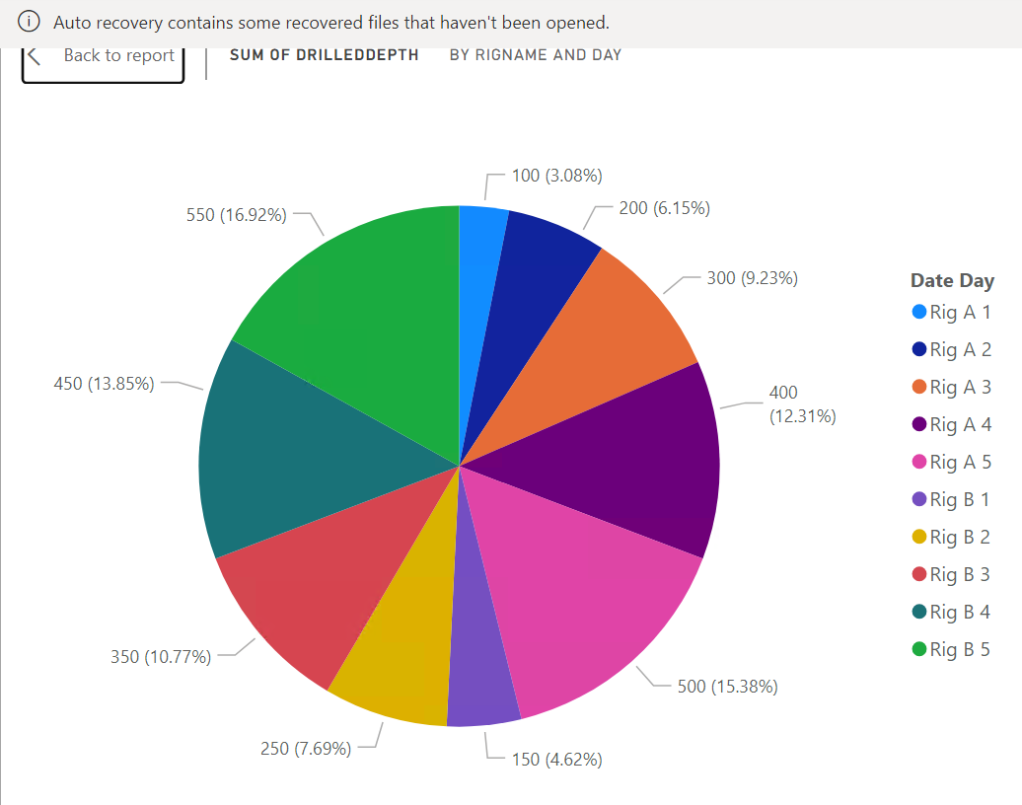
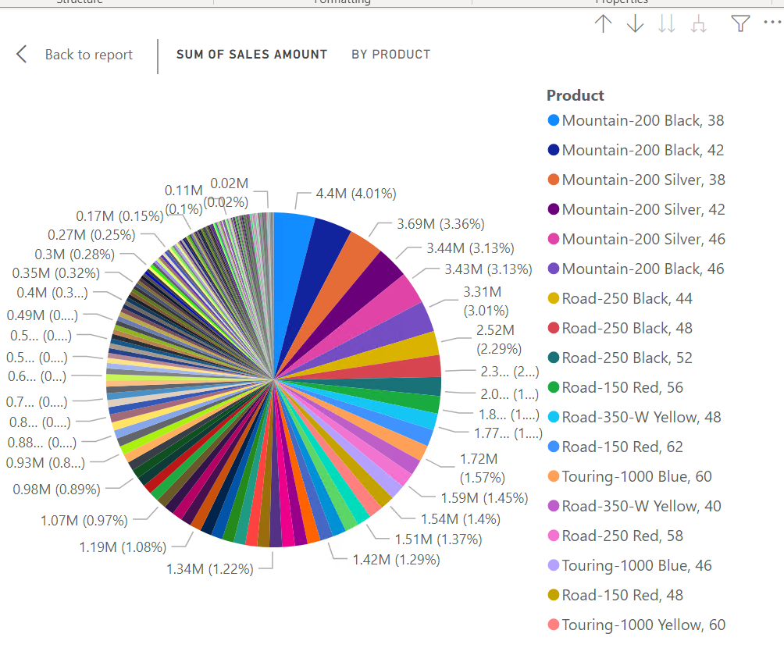
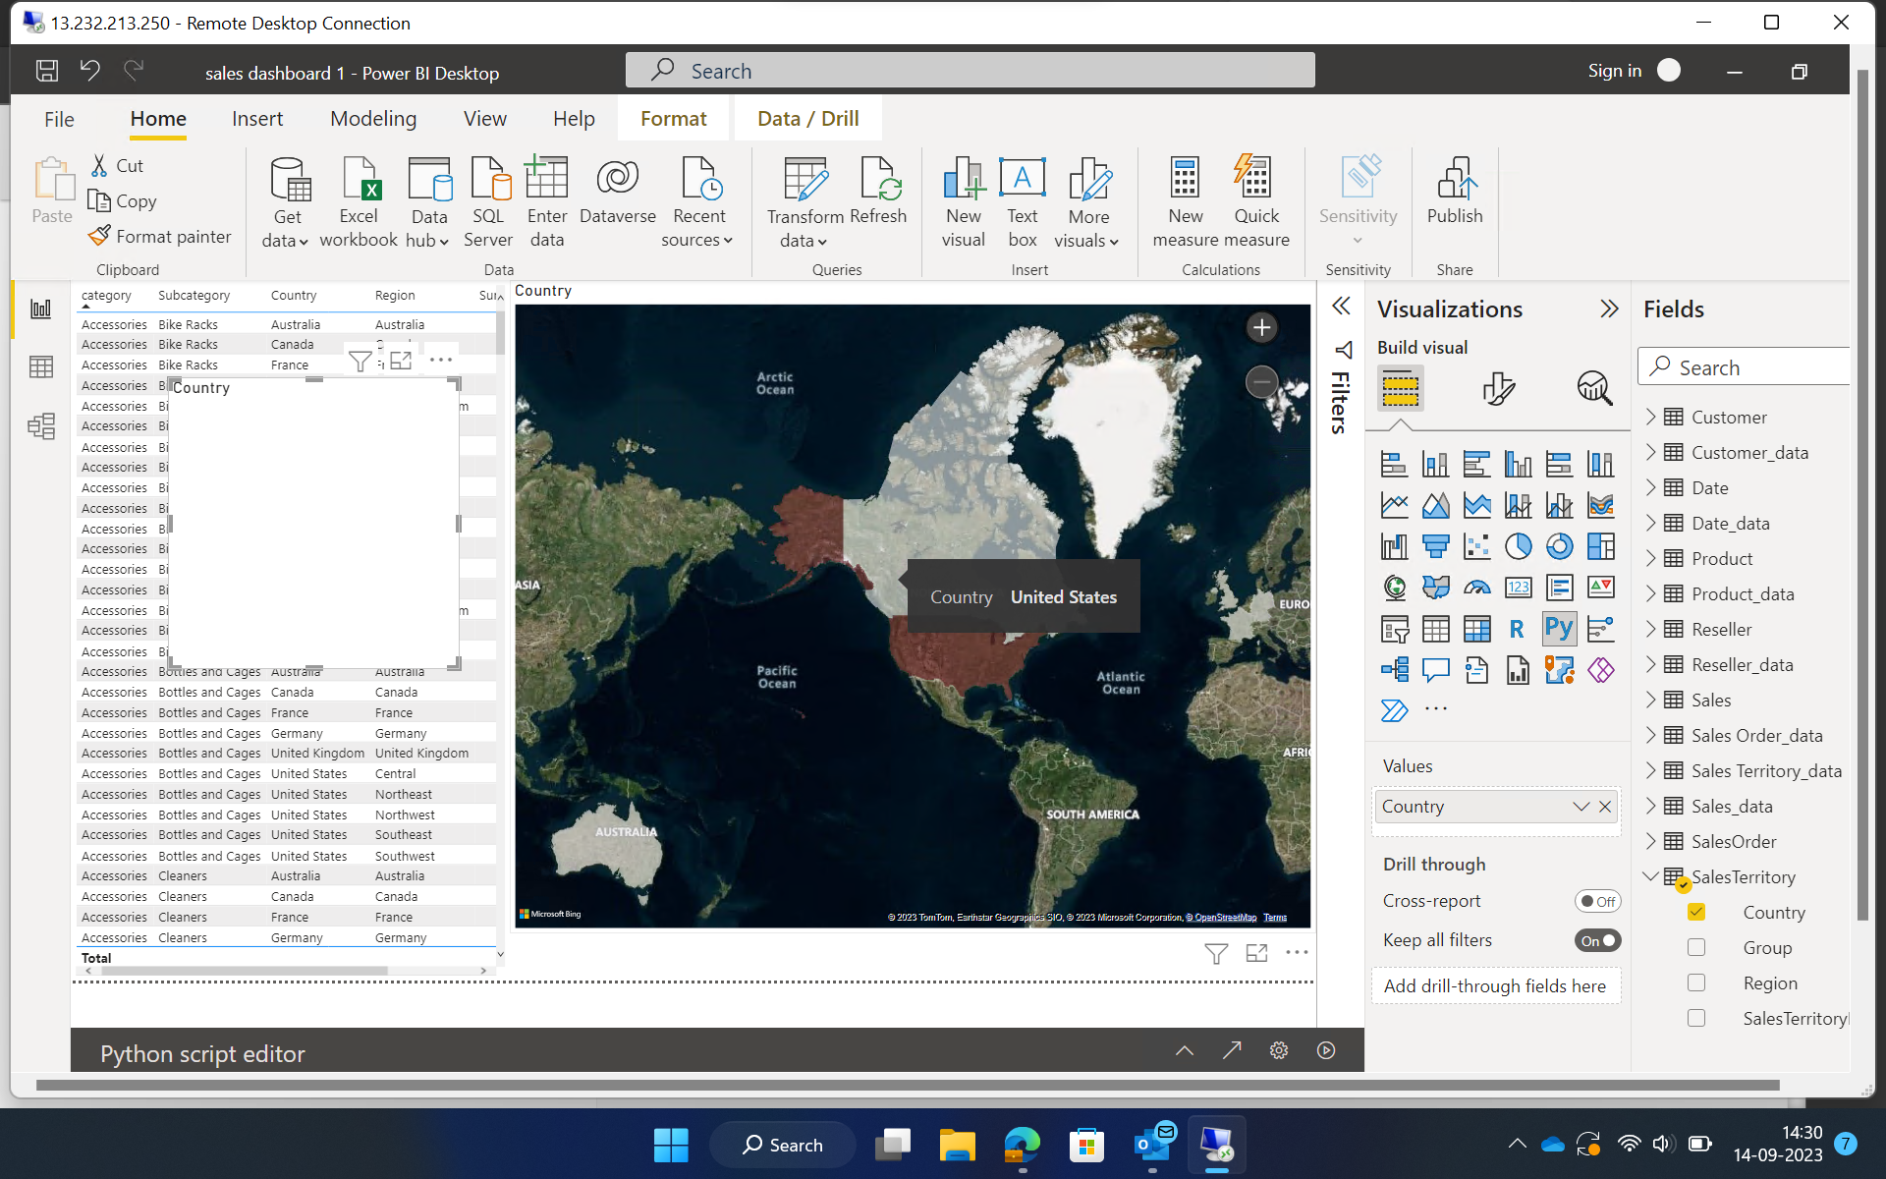
Created various reports

Slide 13
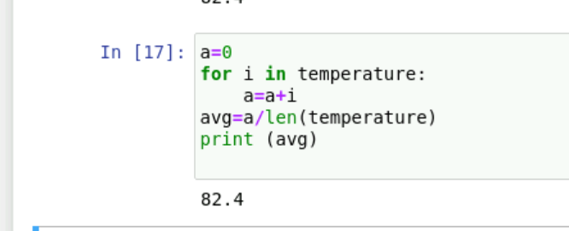
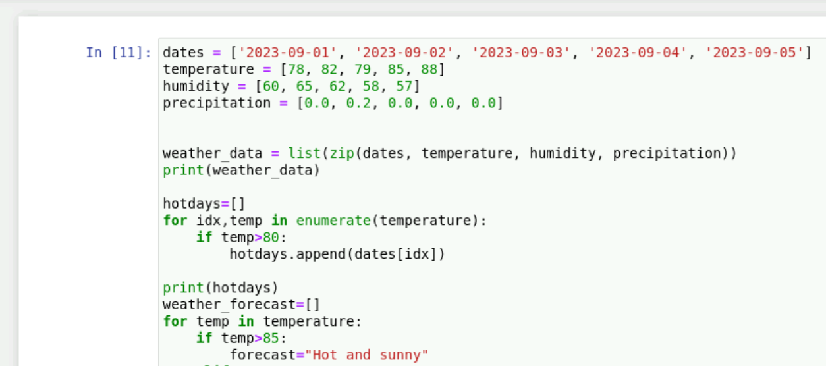
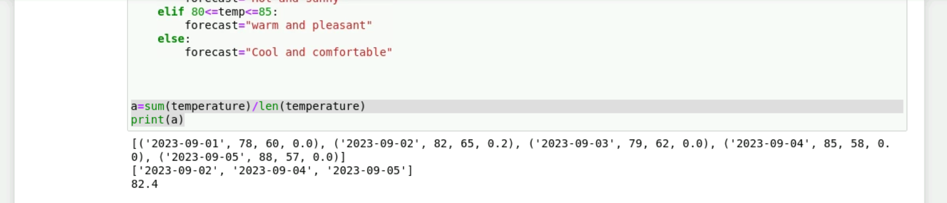
15th September
Performed Hands on task on PowerBi.
Learnt about python and performed some code.

